Slide 1
Advance Data Structures
UNIT-1
Fundamental Concepts
Mrs. Manisha Pawar
Course Instructor
Department of CSE, COEP Technological University, Pune

Slide 2

Key Points : ADT
Data
Data Type
Data Structure
Abstract Data Types
Realization of Data Types

Slide 3
Data
Simply set of values.
In C/C++ language:
Integer data values 0……..9
Character: A…Z, a…..z
A data items refers to single unit of values.
If Data items are divided into subitems then not called basic items
Collection of data are frequently organized into hierarchy of fields, records.

Slide 4
Data: Atomic vs Composite Data
Atomic Data:
Consider as single, Non decomposable data/entity
Can’t divided into subparts
Atomic Data Type:
Set of atomic data with identical properties.
It consist of set values and set of operations on values
Ex:
Character: ‘A’ ….’Z’, ‘a’…..’z’……’\0’ etc. Operations: compare character etc
Integer Value: 100, 1, 67850, 7643 operation: Arithmatic operations, compare etc

Slide 5
Data: Atomic vs Composite Data
Composite Data:
Composition of several atomic data
Divided into atomic data with
Ex:
Employee name
First name, Last name, Middle Name
Telephone number:
Area code, extension no, phone number,
Date of birth:
Day, month, year
Composite data are used in terms as data structure.

Slide 6
Data Types
A Data type consist of two parts
Set of data
The operations that can be performed on the data.
Term which refers to kind of data that variable may hold.
Data types are primarily used in computer programming, in which variables are created to store data.
Each variable is assigned a data type that determines what type of data/ value the variable may contain.
A data type is a classification of data
Which can store a specific type of information.
Ex. float→ 90.9, 89.57
Integer→ 122, 57, 2, 45789

Slide 7
Built in Data Types
Primary Data/Primitive/ Built in data/Basic data type:
Integer, float, character, void
Derived Data/ Non Primitive:
Array, Function, Pointer
User Defined Data Type:
Enumeration, Typedef, Structure, Union,

Slide 8
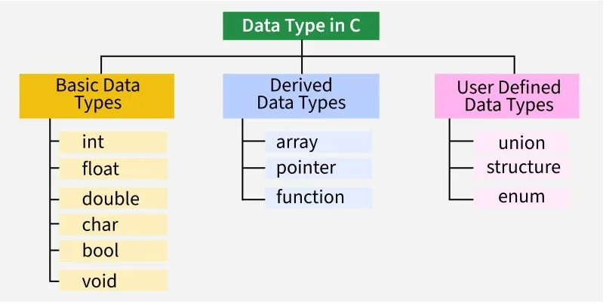
Classification of Data Type

Slide 9
Data Structure
It is an aggregation of atomic and composite data type into a set with defined relationship.
Structure refers: set of rules that hold the data together.
i.e. set od association or relationship
Data may be organized many different ways
Data structure: Logical or mathematical model of particular organization of data.
It is distinguished from data object is that describe data object and the way that they are related .
Set of operations which may be applied to elements of data object

Slide 10
Data Structure:
Primitive data structures:
Basic data structures and are directly operated upon by the machine instructions, which is in a primitive level.
Example: integers, floating point numbers, characters, string constants, pointers etc.
Non-primitive data structures:
Data structure emphasizing on structuring of a group of
homogeneous (same type) or
Heterogeneous (different type) data items.
Example: Array, list, files, linked list, trees and graphs

Slide 11
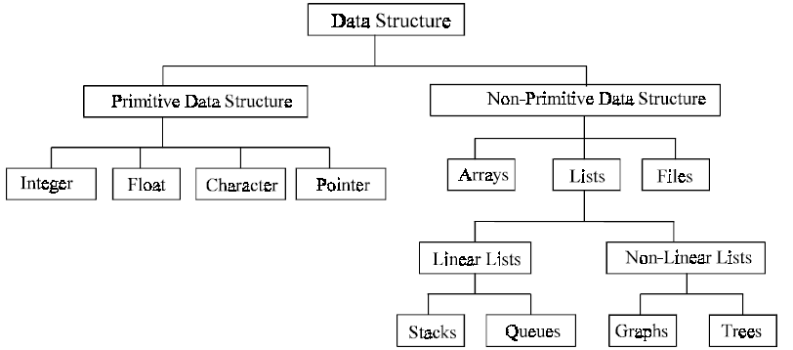
Classification of Data structure

Slide 12
Data Structure
Ex:
Array: homogeneous sequence of data/ data type know as element
Association is position among element.
Records: heterogeneous combination of data into single structure with an key
No association.
Data structure can be nested: Data structure within data structure.

Slide 13
Abstract Data Type: ADT
Need:
Programmer need to implement his own data type, as per his application requirement.
Programmer’s own data referred as ADT
ADT
It has data structure
Set of operations that can be used to read that data structure.
Rule: allows not only to read but to doc other operations
With ADT
user not need to concern how the task is done
But what it can do.

Slide 14
Abstract Data Type: ADT
ADT a type (or class) for objects
whose behavior is defined by a set of value and a set of operations.
ADT only mentions what operations are to be performed but not how these operations will be implemented.
It does not specify how data will be organized in memory and what algorithms will be used for implementing the operations.
The process of providing only the essentials and hiding the details is known as abstraction.
Abstractions:
We know what a data type can do
How it is done is hidden

Slide 15
Abstract Data Type
ADT as a black box which hides the inner structure and design of the data type.
Example: Concept of “list”
Three data structure supports list
We can use array, linked list, file.
Abstract data type is a data declarations packaged together with operations that are meaningful for the data type.
Encapsulate data and operations on data and hide them from user
ADT:
Declaration of data
Declaration of operations
Encapsulation of data and operations.

Slide 16
Abstract Data Type
Encapsulation
Operation on the ADT can only be done by calling the appropriate function
not mention of how the set of operations is implemented
The definition of the type and all operations on that type can be localized to one section of the program
We can treat the ADT as a primitive type:
ADT as C++: class
method as C++: member function

Slide 17
Abstract Data Type
ADT consist of
Set of definitions that allow programmer to use functions while hiding implementations.
ADT defines:
Set of Domains ‘D’
Set of Functions ‘F’
Set of Rules/ Axioms ‘A’
ADT denotes Abstract Data Structure
Three ADTs namely
List ADT
Stack ADT
Queue ADT.

Slide 18
Abstract Data Type : Array as ADT
ADT as a black box which
hides the inner structure and
design of the data type.
Example
Set as ADT;
A set of elements
Operations: union, intersection, size and complement
Queue ADT.
A set of sequences of elements
Operations: create empty queue, insert, examine, delete, and destroy queue
List as ADT
Stack as ADT

Slide 19
Abstract Data Type : Array as ADT
Array-1D Array-finite ordered set of homogeneous element
Finite: specific numbers of elements in an array
Ordered: elements are arranged in sequence 0th ,1st , 2nd ….
Homogeneous : Same of data
Two basic operations to access an array:
Extract: accepts an array and an index I, return elements on the array →a[i]
Sorting: accepts an array, an index i, and element, return updated array
a[i]=x
Smallest array’s index=lower bound
Highest index =upper bound
Range=numbers of elements in an array upper bound - lower bound +1
C array is not changed during program’s execution
Lower bound is fixed always zero and upper is fixed at time of program written

Slide 20
Abstract Data Type: Array as ADT
Array-1D
Data: Array-finite ordered set of homogeneous element
Finite: specific numbers of elements in an array
Ordered: elements are arranged in sequence 0th ,1st , 2nd ….
Homogeneous : Same of data
Operations on an array:
Extract
Store
Delete an element
Insert an element
Display
Search
Sort
Display reverse array
Merge two arrays
Length of array

Slide 21
Abstract Data Type: List as ADT
A list contains elements of the same type arranged in sequential order.
A sequence of zero or more elements
Example: A1, A2, A3, …… An
Rules:
Size/ length of the list: n
A1: first element
An: last element
Ai: element at position I
Linearly ordered: Ai have Ai+1 successor and Ai-1 as predecessor

Slide 22
Abstract Data Type: List as ADT
Operations on List
print( ) – print the list / display the elements
insert( ) – Insert an element at any position of the list.
Remove
removefirst( ) – Remove the first occurrence of any element from a non-empty list.
removeAt( ) – Remove the element at a specified location from a non-empty list.
replace( ) – Replace an element at any position by another element.
size( ) – Return the number of elements in the list.
isEmpty( ) – Return true if the list is empty, otherwise return false.
isFull( ) – Return true if the list is full, otherwise return false.

Slide 23
ADT: Implementation
Choose a data structure to represent the ADT
E.g. arrays, records, etc.
Each operation associated with the ADT is implemented by one or more subroutines
Two standard implementations for the list ADT
Array-based:
Elements are stored in contiguous array positions
Requires an estimate of the maximum size of the list
Linked list:
Ensure that the list is not stored contiguously

Slide 24
Abstract Data Type: Stack as ADT
A Stack contains elements of the same type arranged in sequential order.
All operations take place at a single end →top of the stack.
Last In First Out or First In Last Out
Operations:
push() – Insert an element at one end of the stack called top.
pop() – Remove and return the element at the top of the stack, if it is not empty.
size() – Return the number of elements in the stack.
isEmpty() – Return true if the stack is empty, otherwise return false.
isFull() – Return true if the stack is full, otherwise return false.

Slide 25
Abstract Data Type: Queue as ADT
A Queue contains elements of the same type arranged in sequential order.
Operations take place at both ends
Insertion is at the end→ Rear
Deletion is at the another end→ front.
Operations:
enqueue() – Insert an element at the end of the queue.
dequeue() – Remove and return the first element of the queue, if the queue is not empty.
peek() – Return the element of the queue without removing it, if the queue is not empty.
size() – Return the number of elements in the queue.
isEmpty() – Return true if the queue is empty, otherwise return false.
isFull() – Return true if the queue is full, otherwise return false

Slide 26
Abstract Data Type: Summary
Data type: Term which refers to kind of data that variable may hold.
Atomic data: non-decomposable
Composite data: can be decomposed into atomic data
Data structure: Logical or mathematical model of particular organization of data
Abstract data type: is data declaration package together with operations that are meaningful for data type.

Slide 27
Thank you!!
Happy Learning!!

